Slide 1
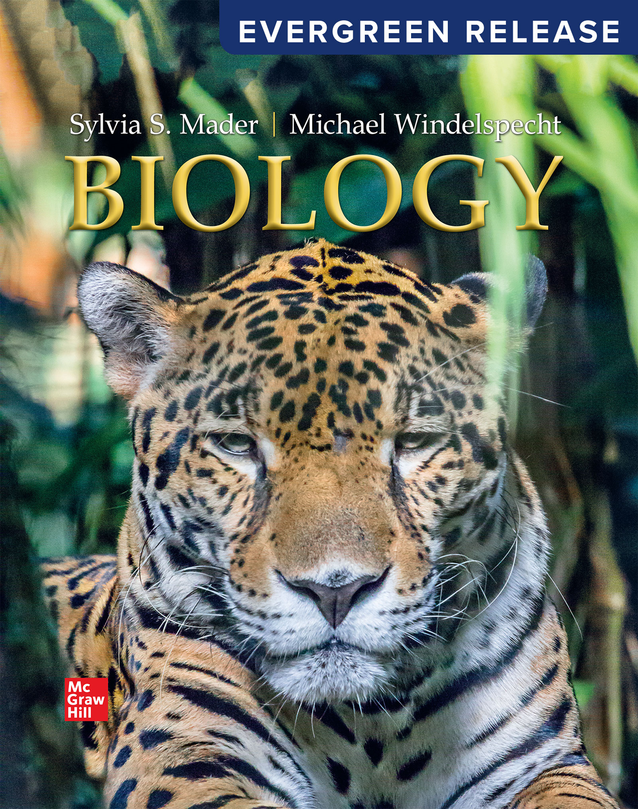
Biology
Sylvia S. Mader Michael Windelspecht
Chapter 25 Flowering Plants: Nutrition and Transport
Lecture Outline
See separate FlexArt PowerPoint slides for all figures and tables pre-inserted into PowerPoint without notes.
Access the text alternative for slide images.

Slide 2
Outline
25.1 Plant Nutrition and Soil
25.2 Water and Mineral Uptake
25.3 Transport Mechanisms in Plants

Slide 3
25.1 Plant Nutrition and Soil
  About 95% of a plant’s dry weight is carbon, hydrogen, and oxygen.
  These are the building blocks for organic compounds such as carbohydrates.
  Primary nutrients include carbon dioxide (organic compound) and water.
    Carbon dioxide supplies carbon, and water supplies hydrogen and oxygen.
  Mineral—Inorganic substance usually containing two or more elements

Slide 4
Essential Inorganic Nutrients
A nutrient is essential if:
  it has an identifiable role,
  another nutrient cannot substitute for it, and
  a deficiency of the nutrient causes a plant to die.
Essential nutrients are divided into macro- and micronutrients according to their relative concentrations in plant tissues.
Macronutrients—C, H, O, P, K, S, C a, Mg
Micronutrients—F e, B, M n, C u, Z n, C l, M o

Slide 5
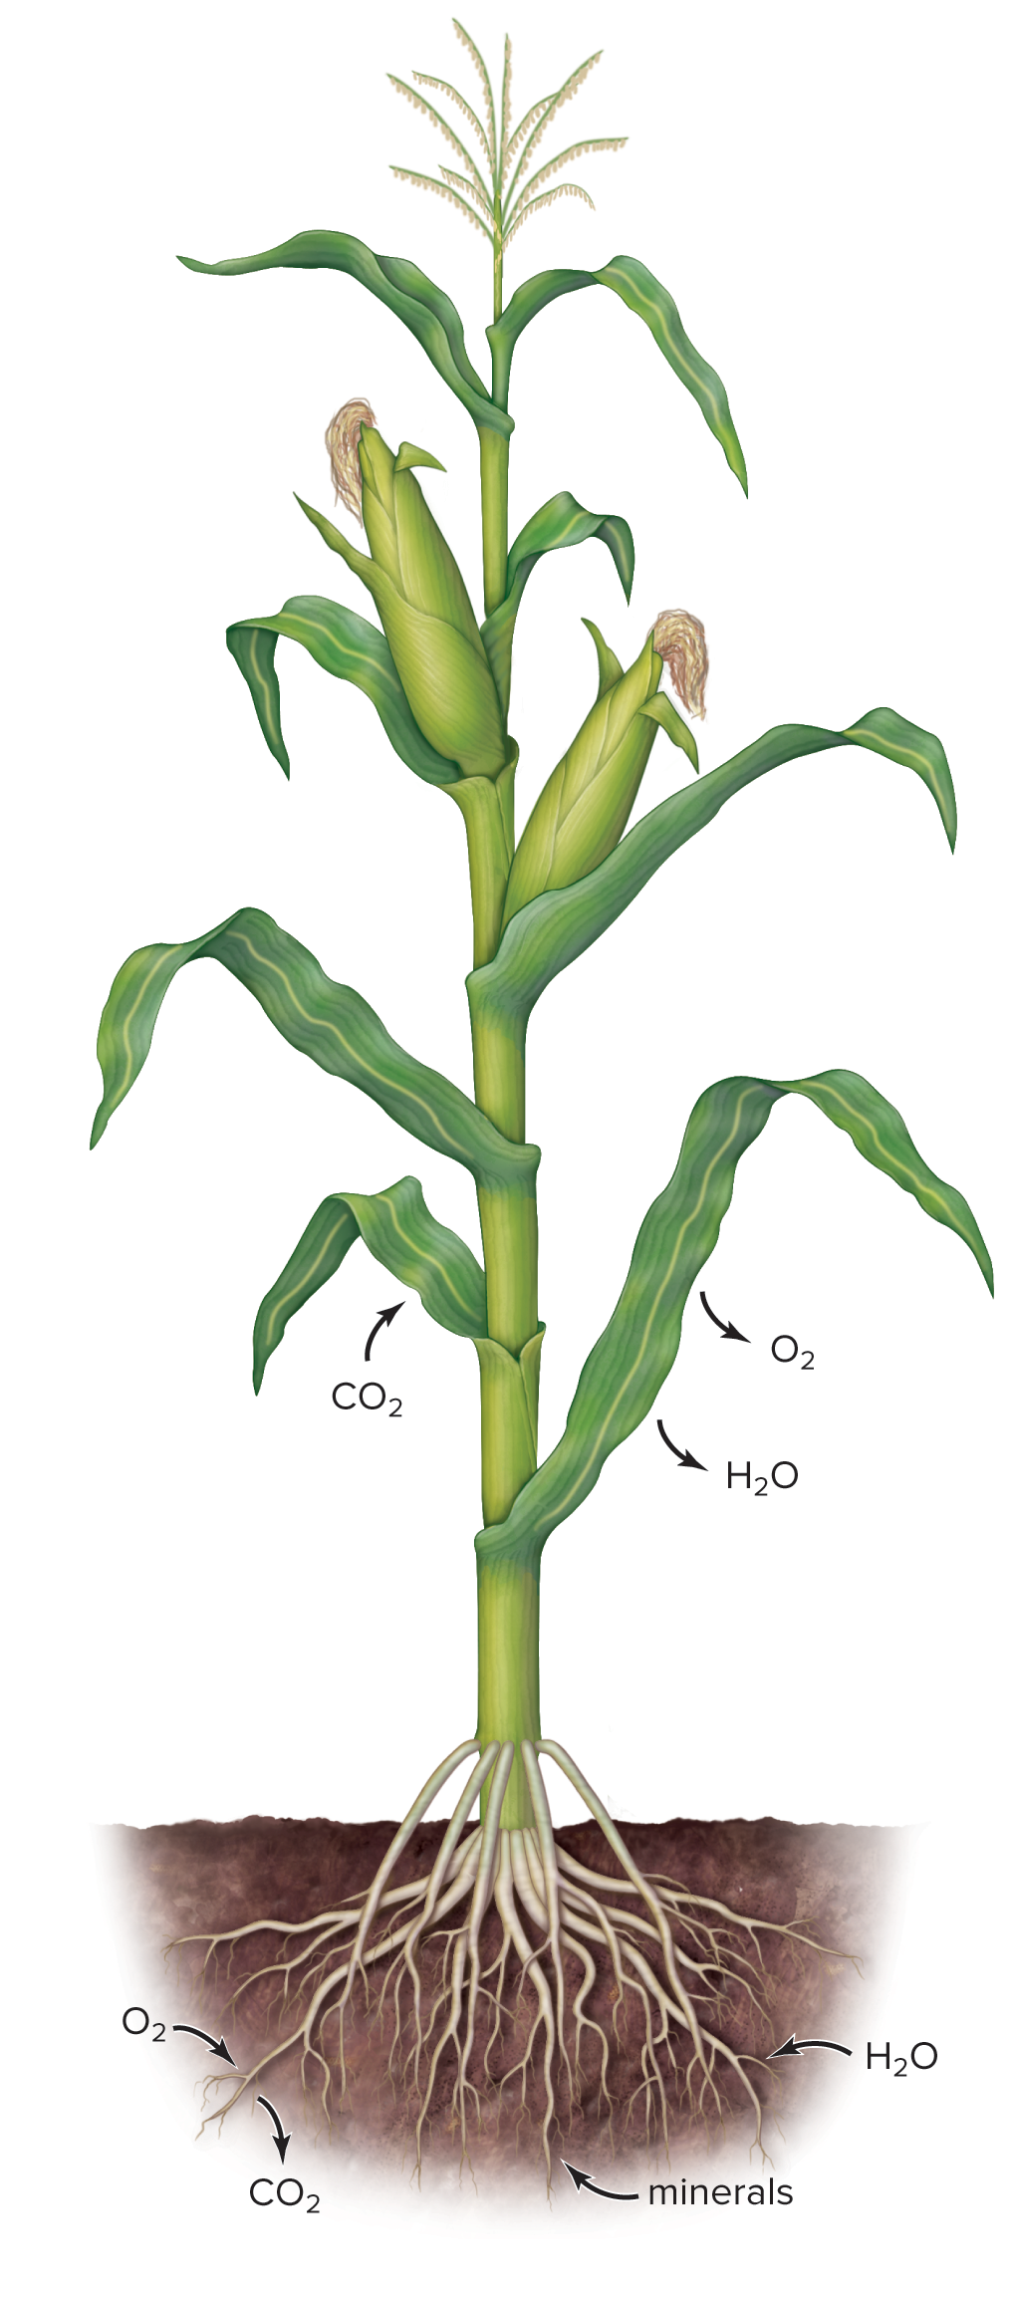
Overview of Plant Nutrition
Figure 25.1

Slide 6
Determination of Essential Nutrients
  Hydroponics allows plants to grow if they are supplied with the nutrients they need.
  It proved that plants grow well if supplied with sunlight, water, and minerals.
  Omitting a particular nutrient from liquid medium and observing growth effects allowed scientists to test for nutritional deficiencies.
  Besides stunted growth, other deficiencies were observed.
Farmers and gardeners use fertilizer to avoid deficiencies.
NPK ratio describes the percentage by weight of nitrogen, phosphorus, and potassium contained in fertilizer.

Slide 7
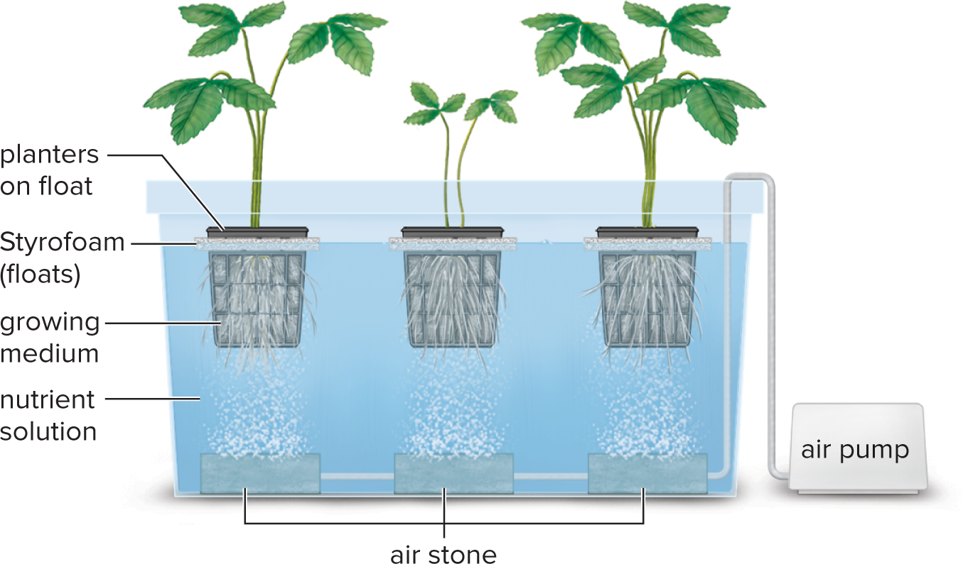
Hydroponics
Figure 25.2
Access the text alternative for slide images.

Slide 8
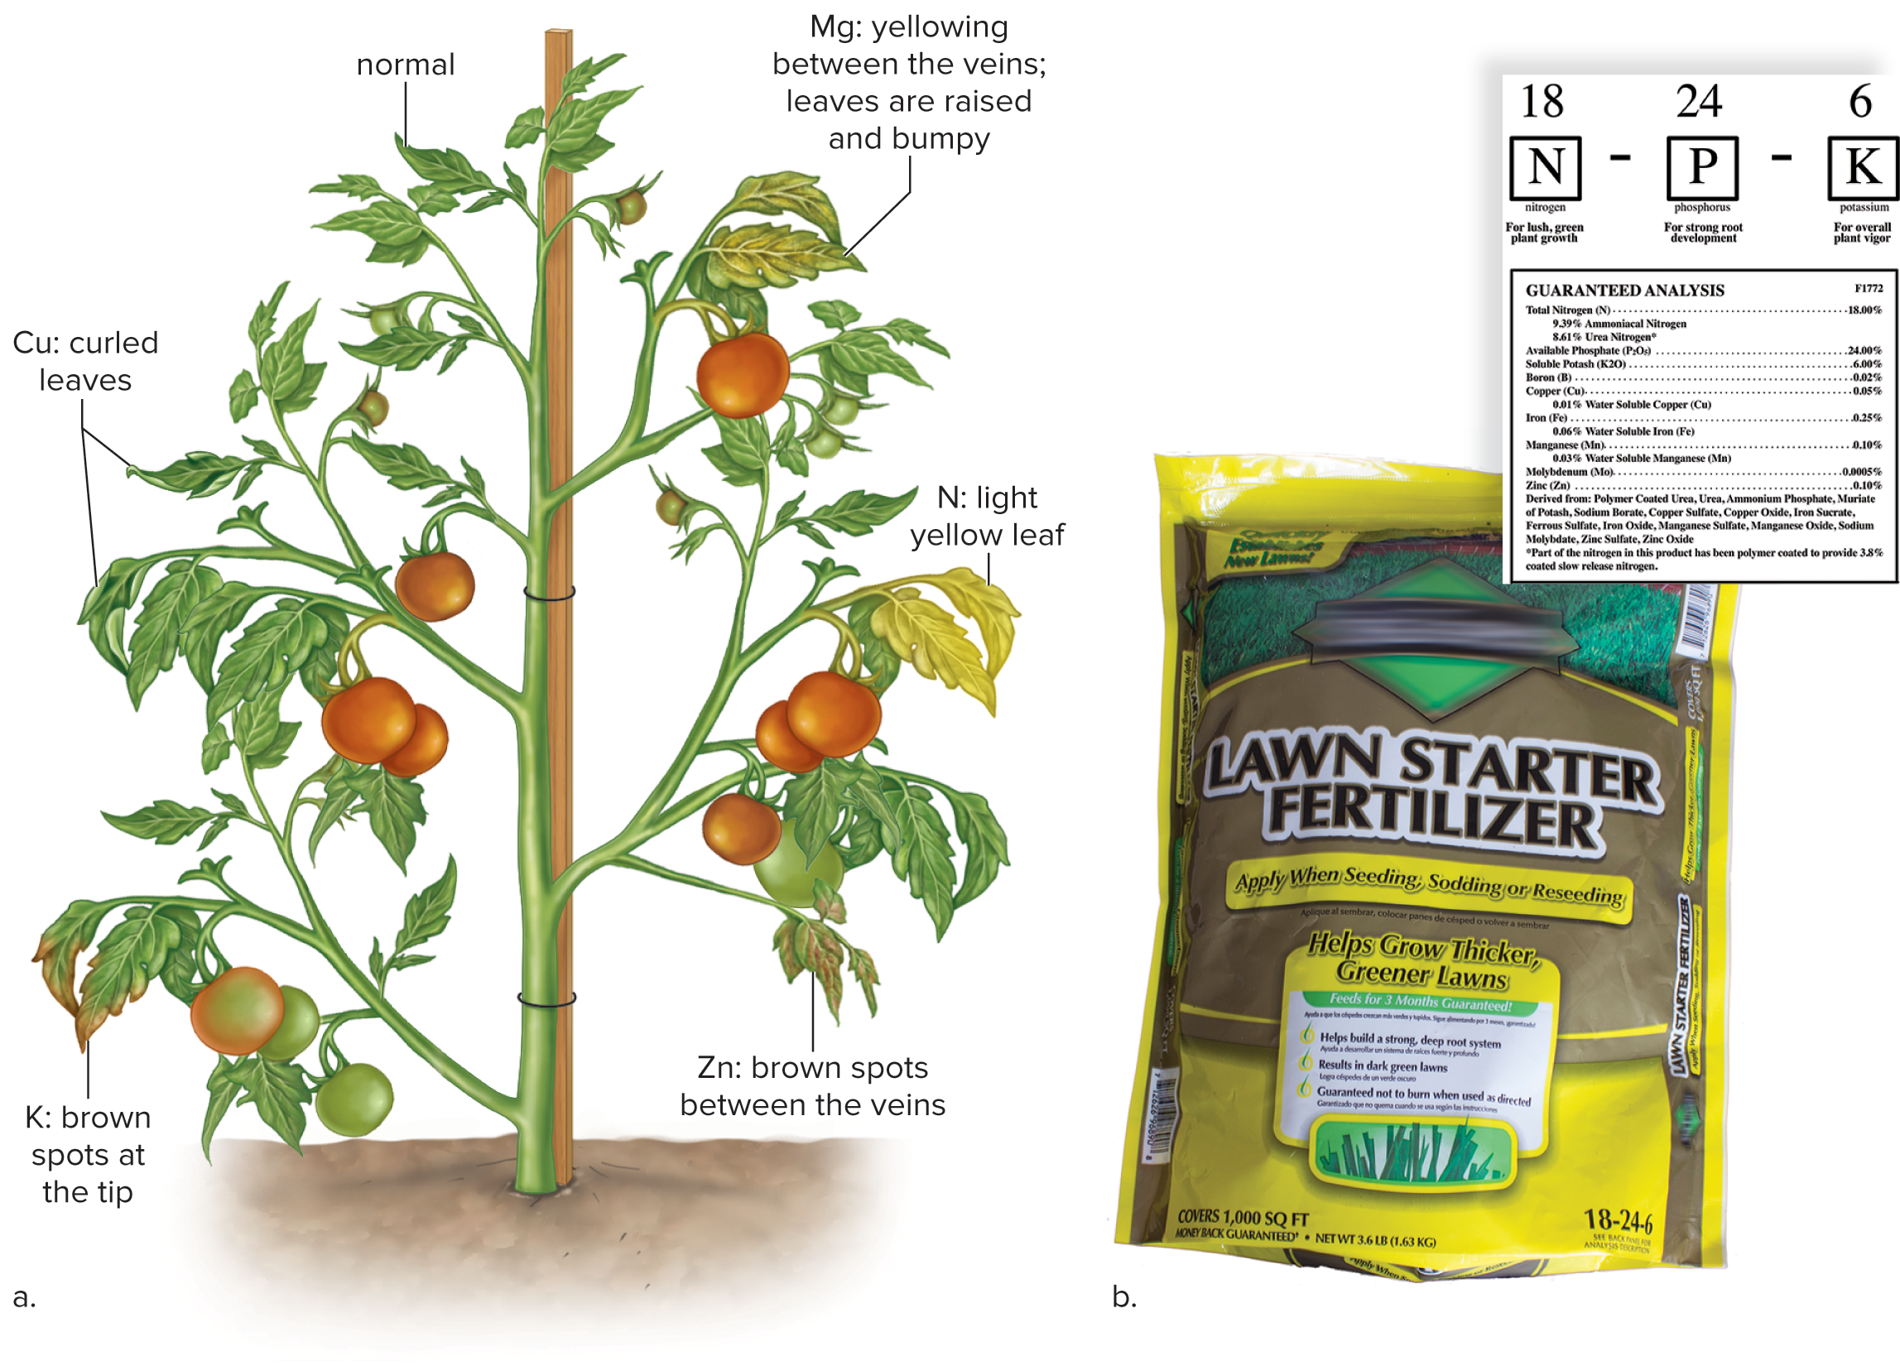
Nutrient Deficiencies and Fertilizer
Figure 25.3
Access the text alternative for slide images.
(b): Leah Moore/Ricochet Creative Productions LLC

Slide 9
Soil
Soil—mixture of mineral particles, decaying organic material, living organisms, air, and water
  Supports growth of plants
Soil Formation
  Begins with weathering of rock
    Can be mechanical (wind, rain, ice, grinding of rock on rock) or chemical (acid rain or degradation by lichen or moss)
  Organisms play a key role
    Lichens
    Mosses
      Humus—decaying organic material

Slide 10
Soil Particles
Soils are a mixture of three types of particles.
  Sand
    0.05–2.0 mm in diameter.
    Water drains readily between adjacent sand particles.
  Silt
    0.002–0.05 mm in diameter.
  Clay
    Less than 0.002 mm in diameter.
    Consists of small spaces that fill with water.
  Loam soil combines the aeration of sand and mineral retention of silt and clay.
  Soil needs a healthy balance of clay particles and humus.

Slide 11
Humus
Humus increases the benefits of soil.
  10–20% best humus concentration.
  Decreases runoff.
  Prevents leaching.
  Makes soil more acidic.
    Retains positively charged minerals
  Organic matter, broken down by bacteria and fungi, is returned to plants.

Slide 12
Healthy Soil
Negatively charged clay and humus bind to positively charged minerals, calcium, and potassium.
  It prevents leaching.
Cation exchange—process by which hydrogen and other positive ions exchange places with positively charged minerals.
  It allows roots to take up nutrients.
Cation exchange capacity (CEC)—availability of negative charge sites which can bind positive cations.
  CEC of sandy soils is less than those with clay and humus mixed in.

Slide 13
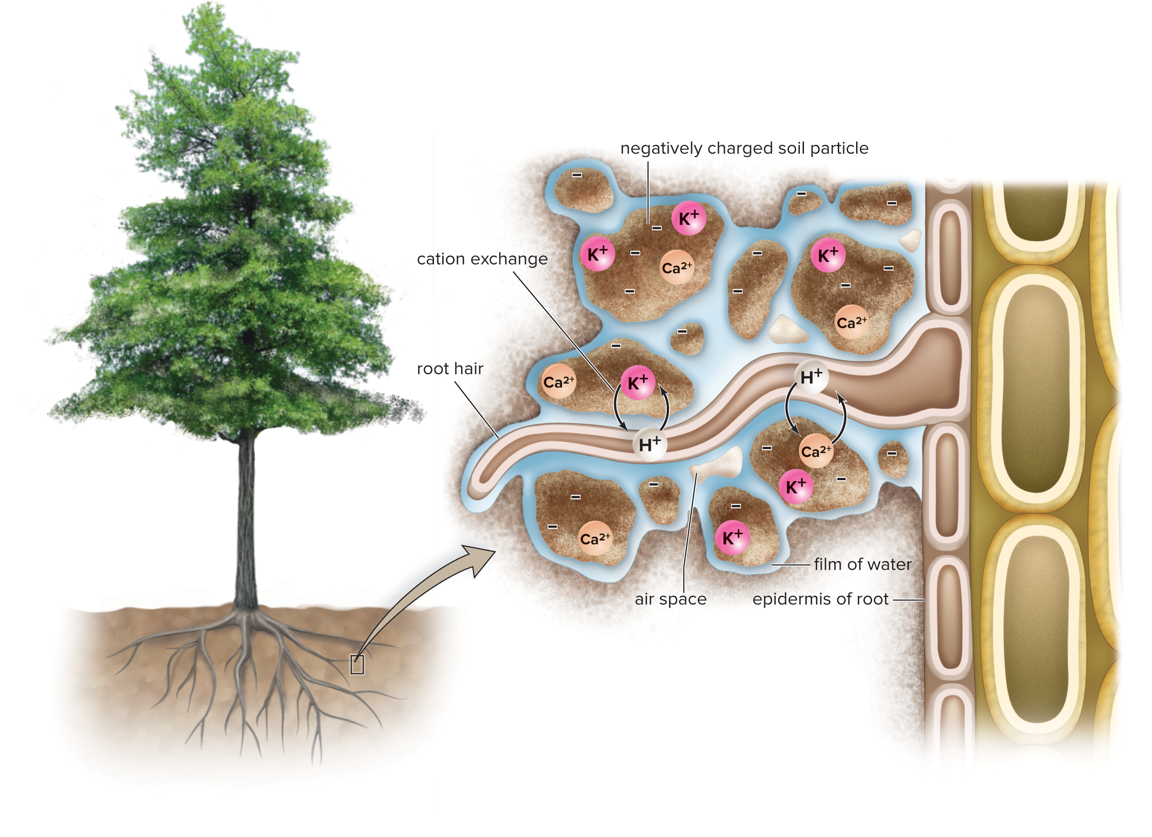
Components of Healthy Soil
Figure 25.5
Access the text alternative for slide images.

Slide 14
Living Organisms
  Small plants help form soil from rock.
  Large plants become dominant in certain ecosystems (succession).
    Roots penetrate soil to bedrock, opening soil for water, air, and animals.
  Soil-dwelling animals mix soil by burrowing.
  Earthworms ingest soil particles and deposit them as worm casts.
    They also aerate soil.
  Soil-dwelling ants construct colonies and loosen and aerate soil.
  Microorganisms are responsible for decomposition of humus.
    Soil bacteria also make nitrogen available to plants.

Slide 15
Soil Profiles
A soil profile is a vertical section from ground surface to unaltered rock below.
  Soil horizons—parallel layers
    A (topsoil)—litter and humus
    B (subsoil)—inorganic nutrients
    C (parent material)—weathered rock
  Because parent material and climate differ, the soil profile varies according to the particular ecosystem.

Slide 16
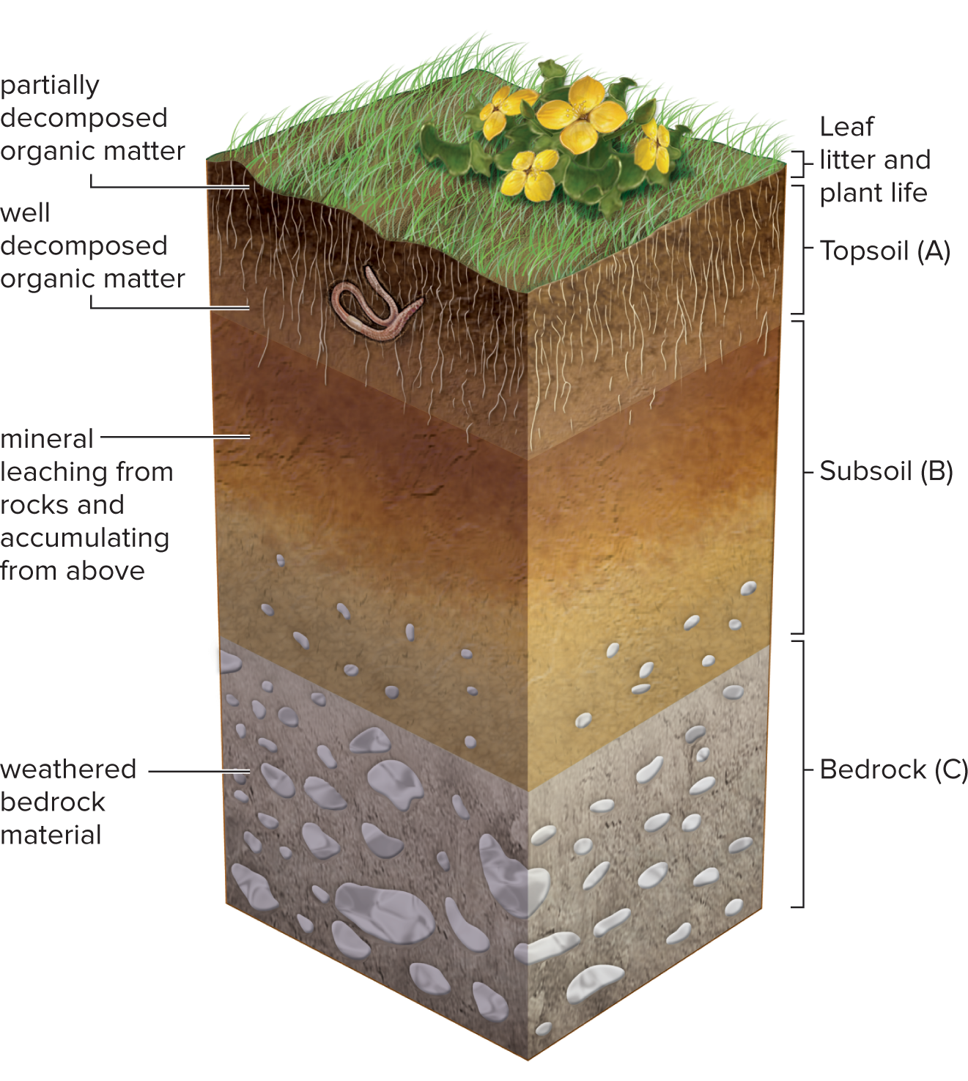
Simplified Soil Profile
Soil Profile Layers
Topsoil (A)
Top layer, containing the most humus
Subsoil (B)
Accumulation of leached materials
Bedrock (C)
Weathered parent material
The following content is arranged like a table. Table divided into 3 columns summarizes Soil Profile Layers. The column headers are marked as: Topsoil (A), Subsoil (B) and Bedrock (C)
Figure 25.6
Access the text alternative for slide images.

Slide 17
Soil Erosion
Soil erosion occurs when water or wind carries soil away to a new location.
Worldwide, at least 40% of farmland is seriously degraded.
Fertile soil in an area equal to the size of Texas is lost annually.
Poor land management practices contribute to erosion.
  Farmland erosion caused by plowing and overgrazing.
  Clearing of land for urbanization and roads.
  Coastal erosion increased by intensification of storms and rising sea levels.

Slide 18
Mitigation Strategies for Soil Erosion
  Effective practices to reduce farmland erosion include crop rotation, reduced tillage, and companion crops.
  In California, coastal erosion has reshaped landscapes.
    Trees are critical for the prevention of coastal erosion.

Slide 19
25.2 Water and Mineral Uptake
Water and minerals enter the roots of flowering plants through the same pathways.
  Between porous cell walls, then forced into endodermal cells by the Casparian strip.
  Through root hairs, through cells across the cortex and endodermis via cytoplasmic strands within plasmodesmata.
Water enters root cells when their osmotic pressure is lower than that of the soil.
Minerals are actively taken up by plant cells and are transported in the xylem along with water.

Slide 20
Mineral Uptake
Plants acquire minerals through passive or active transport.
Plant cells expend energy to actively take up and concentrate mineral ions.
The Casparian strip prevents backflow of minerals and allows root xylem to have a higher mineral concentration than soil.
  Roots can concentrate minerals 10,000 times greater than surrounding soil.

Slide 21





Proton Pump
A plasma-membrane proton pump can transport
hydrogen ions
out of the cell.
An electrochemical gradient drives positively charged
ions
into the cell.
Negatively charged mineral ions
are
transported with
by carrier proteins.
No energy is required when
is moving down its
concentration gradient.
This model of mineral ion transport is called chemiosmosis, which occurs when an electrochemical gradient is used by a cell to do work.
Minerals move into xylem and then are transported into leaves.

Slide 22
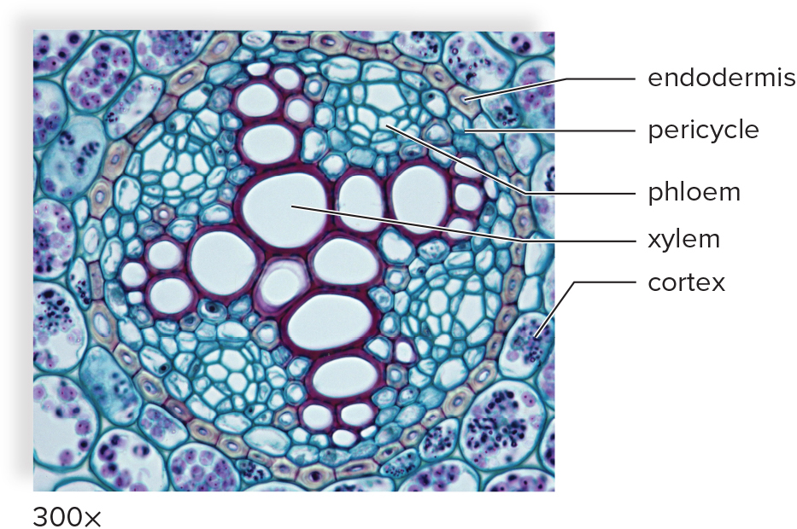
Water and Mineral Uptake 1
Figure 25.7
Ed Reschke/Stone/Getty Images

Slide 23
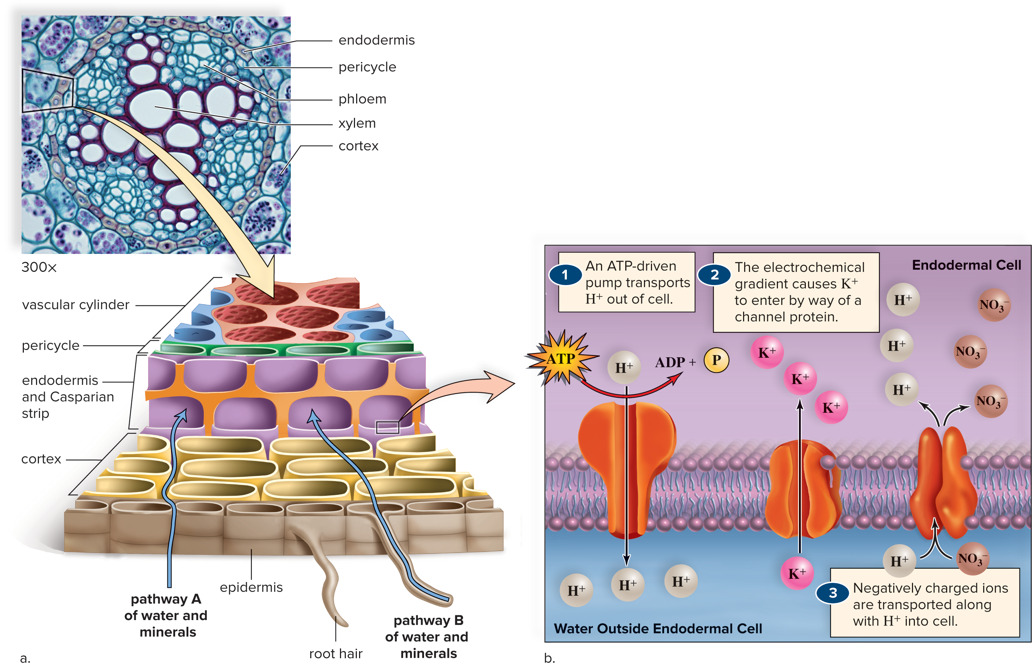
Water and Mineral Uptake 2
Figure 25.7
Access the text alternative for slide images.
(photo): Ed Reschke/Stone/Getty Images

Slide 24
Adaptations of Roots for Mineral Uptake
  Important mutualistic relationships:
    Rhizobium bacteria live in root nodules.
      Bacteria fix atmospheric nitrogen.
      Host plant provides the bacteria with carbohydrates.
    Mycorrhizal association between fungi and plant roots
      Fungus increases the surface area for water and mineral uptake and breaks down organic matter.
      The root provides the fungus with sugars and amino acids.
  Parasitic plants
  Carnivorous plants

Slide 25
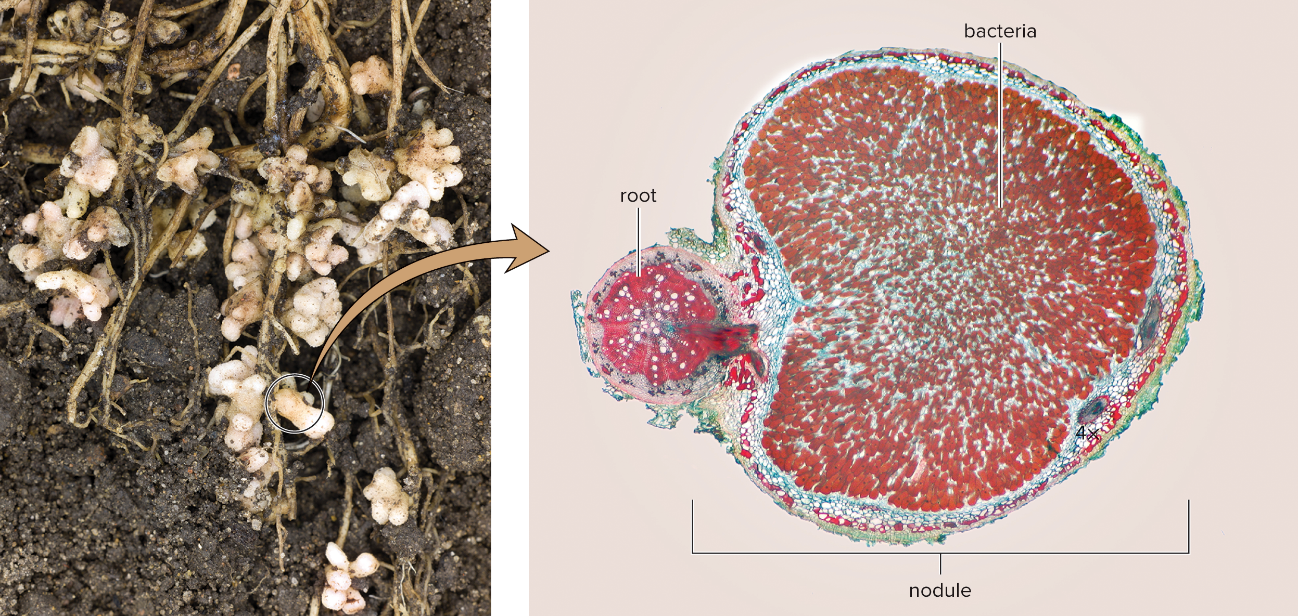
Root Nodules
Figure 25.8
(root nodules): Dr. Jeremy Burgess/Science Source; (nodule micrograph): Garry DeLong/Science Source

Slide 26
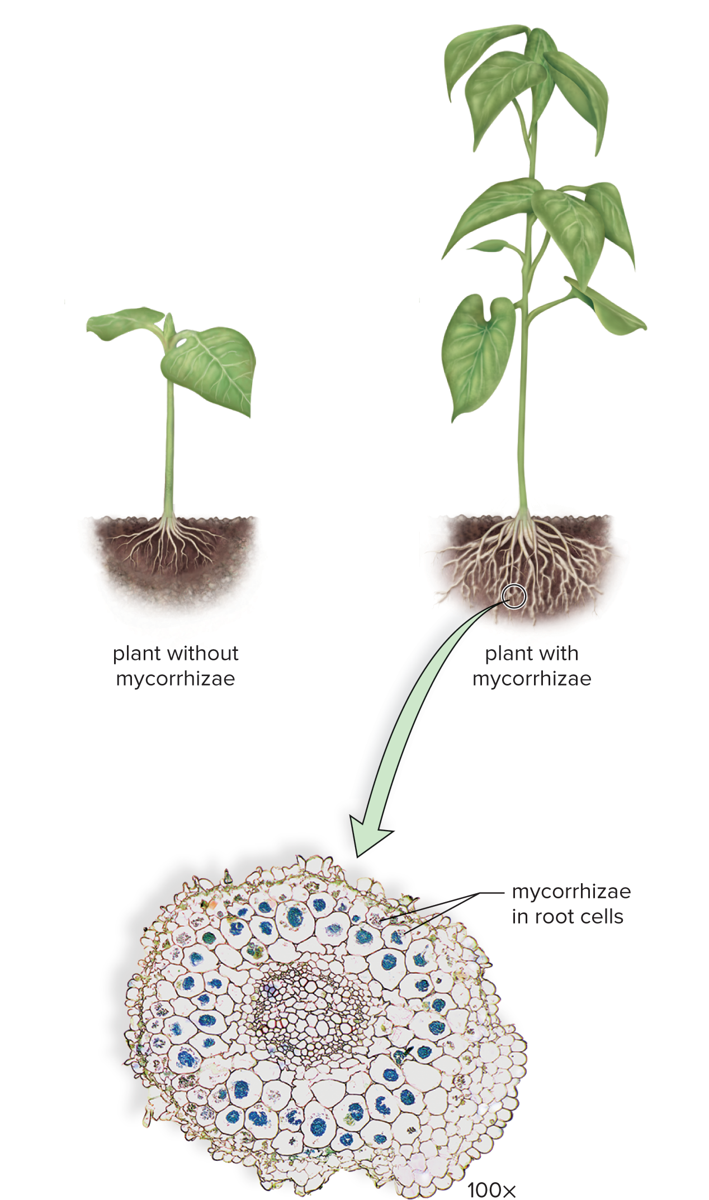
Mycorrhizae
Figure 25.9
Access the text alternative for slide images.
(photo): Dr. Keith Wheeler/Science Source

Slide 27
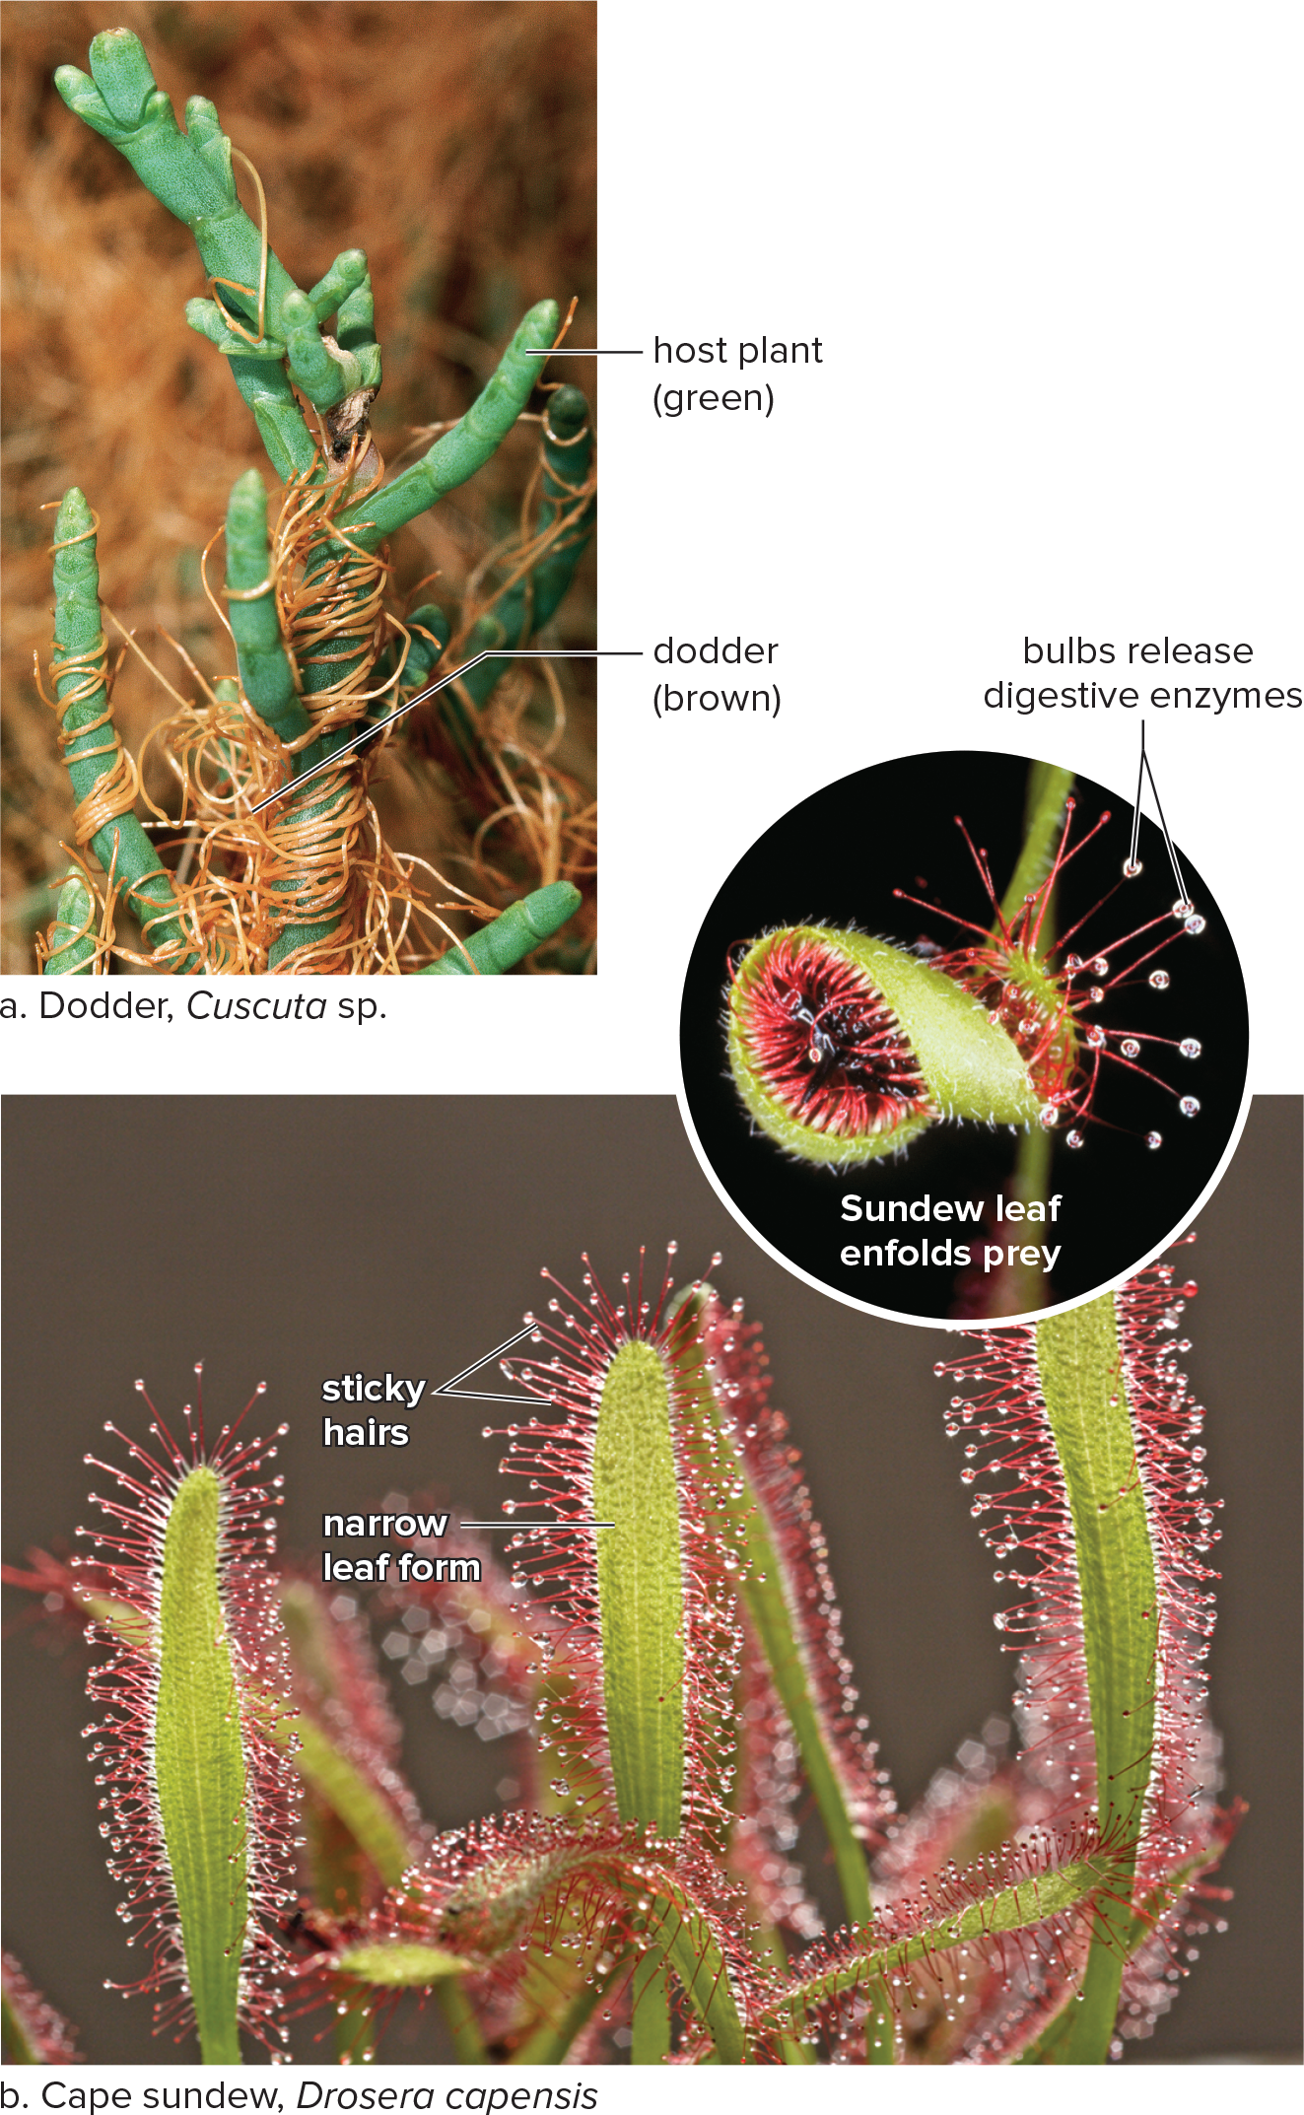
Other Ways Plants Acquire Nutrients
Figure 25.10
Access the text alternative for slide images.
(a): Kevin Schafer/The Image Bank/Getty Images; (b): (plant): blickwinkel/Alamy Stock Photo; (leaf inset): Dr. Jeremy Burgess/Science Source

Slide 28
25.3 Transport Mechanisms in Plants
Vascular tissues transport water and nutrients.
  Xylem transports water and minerals.
    Two types of conducting cells
      Tracheids
      Vessel elements
    Water flows passively from an area of higher water potential to an area of lower water potential.
  Phloem transports organic materials.
    Conducting cells are sieve-tube members.
      They have companion cells to provide proteins.
      End walls are sieve plates.
      Plasmodesmata extend through sieve plates.

Slide 29
Reviewing Xylem and Phloem Structure
  Xylem and phloem form a series of interconnected and parallel cells for movement of water and carbohydrates in a plant.
  Water is moved in xylem from the bottom to the top of the plant.
  Sucrose and other materials can move in any direction through phloem.

Slide 30
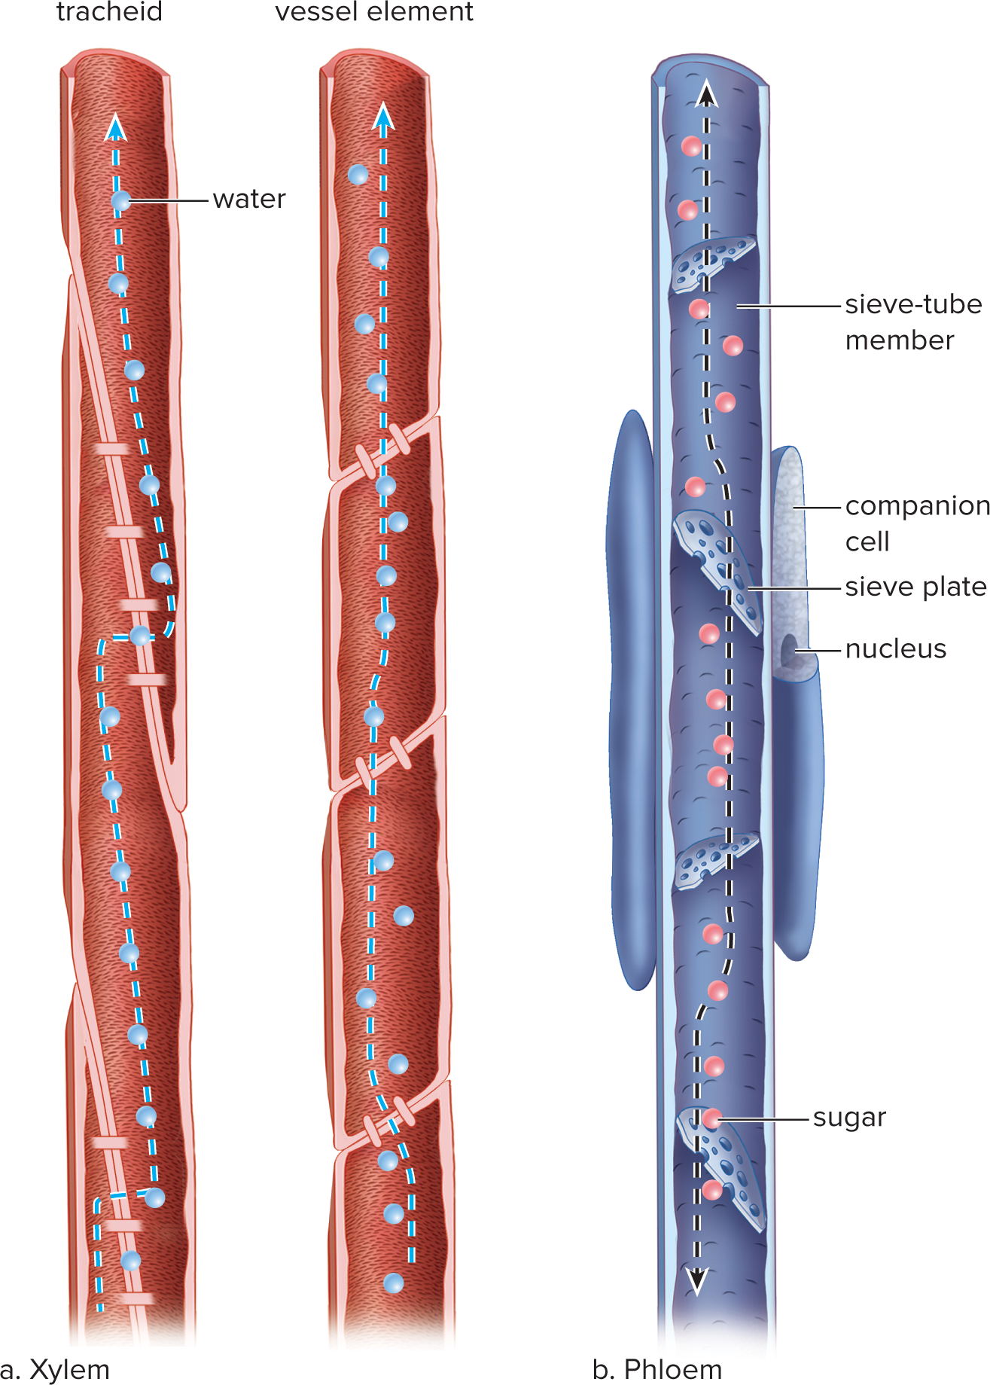
Organization of Conducting Cells in Xylem and Phloem
Figure 25.11
Access the text alternative for slide images.

Slide 31
The Role of Water Potential
Potential energy is stored energy.
Water potential is the energy of water.
  Water moves passively from a region of higher potential to a region of lower potential.
In terms of cells, two factors usually determine water potential:
  Water pressure across a membrane.
  Solute concentration across a membrane.

Slide 32
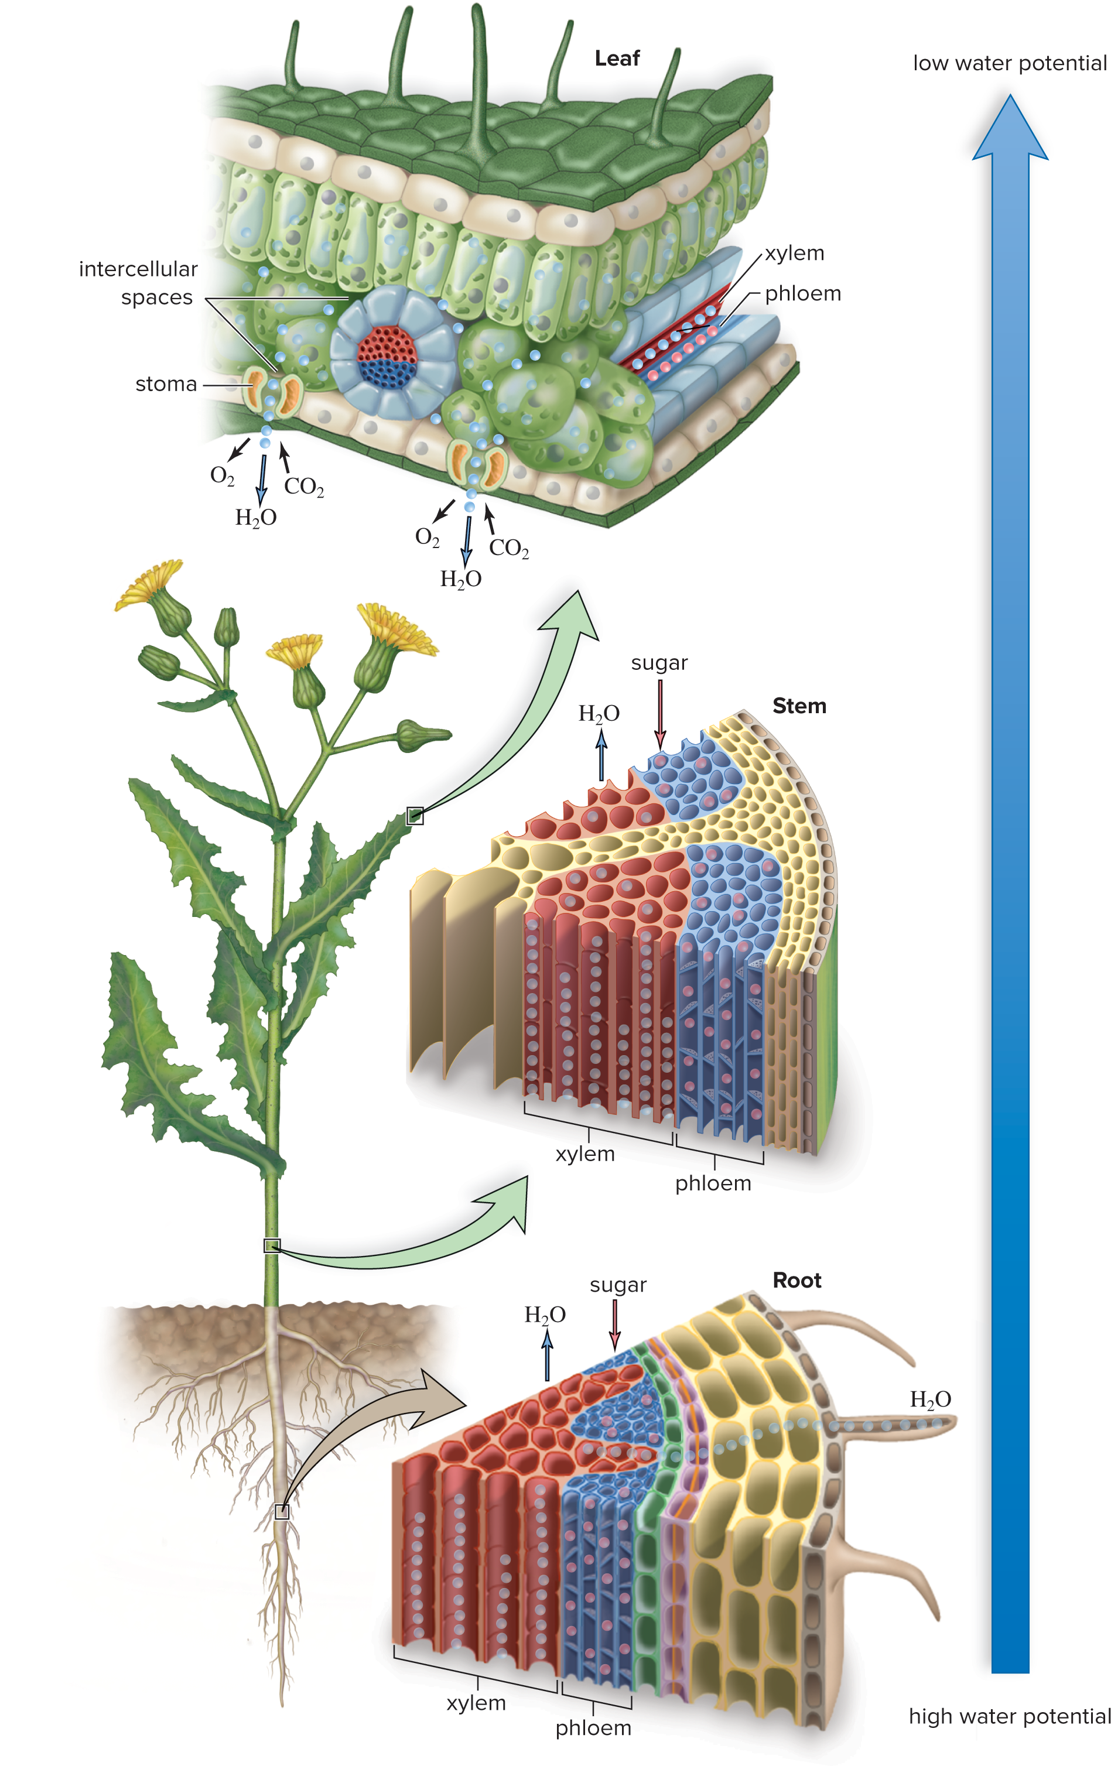
Plant Transport and Water Potential
Figure 25.12
Access the text alternative for slide images.

Slide 33
The Concept of Water Potential
Pressure potential is the effect that pressure has on water potential.
  Water moves across a membrane from the area of higher pressure to the area of lower pressure.
  The higher the water pressure, the higher the water potential.
  Pressure potential that increases due to osmosis is called turgor pressure.
Osmotic potential takes into account the presence of solutes.
  Water tends to move from the area of lower solute concentration to the area of higher solute concentration.
  The lower the concentration of solutes (osmotic potential), the higher the water potential.

Slide 34
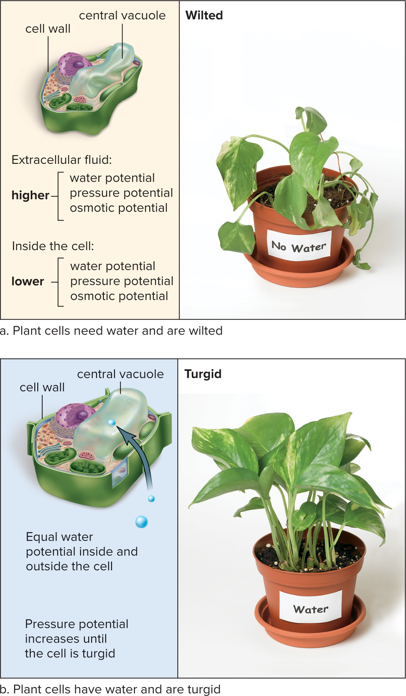
Water Potential and Turgor Pressure
Figure 25B
Access the text alternative for slide images.
(both photos): Ken Cavanagh/McGraw Hill

Slide 35
Water Transport
  Xylem vessels form an open pipeline.
    The vessel elements are separated by perforated plates.
    Water moves into and out of tracheids through pits.
  Water entering roots creates a positive pressure (root pressure).
    It pushes xylem sap upward.
      May be responsible for guttation
        Water forced out vein endings along edges of leaves

Slide 36
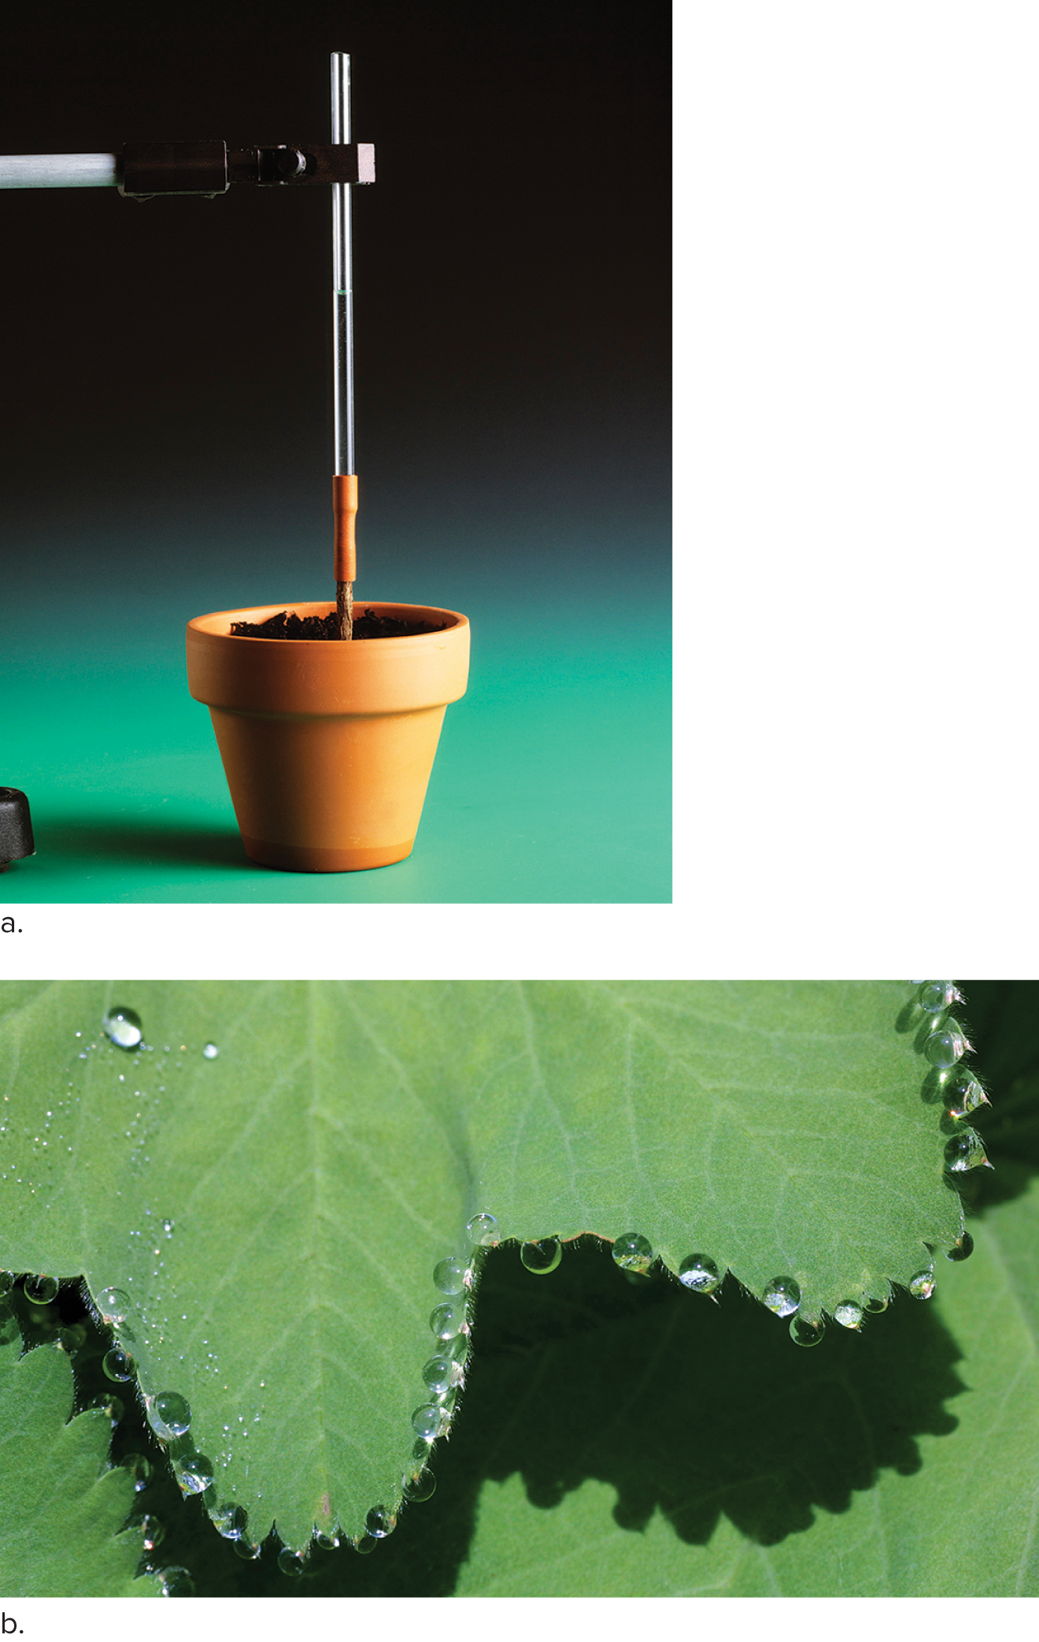
Root Pressure and Guttation
Figure 25.13
(a): Martyn F. Chillmaid/Science Source; (b): H. Schmidbauer/blickwinkel/age fotostock

Slide 37
Xylem Transport Cohesion-Tension Model
Cohesion-tension model of xylem transport suggests a passive xylem transport.
  Cohesion is the tendency of water molecules to cling together.
  Adhesion is the ability of the polar water molecules to interact with molecules of vessel walls.
  A continuous water column moves passively upward due to transpiration.

Slide 38
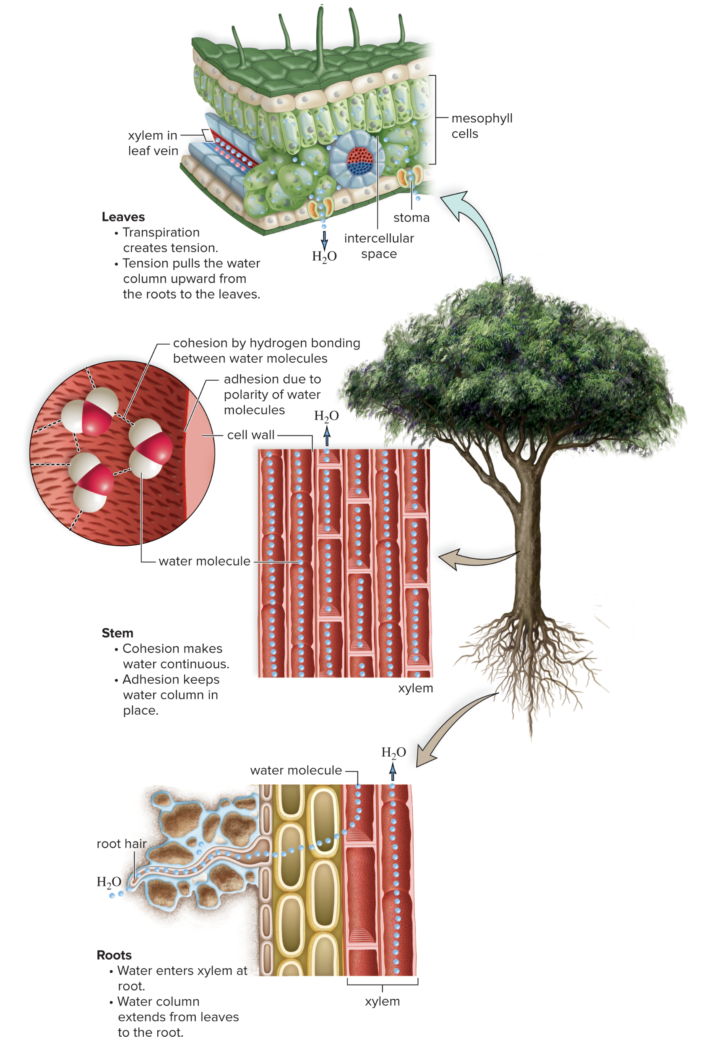
Cohesion-Tension Model of Xylem Transport
Figure 25.14
Access the text alternative for slide images.

Slide 39
Tension in Leaves, Stems, and Roots
Leaves
  Transpiration causes water loss through stomata.
  Water molecules that evaporate are replaced by water molecules from leaf veins.
  Due to cohesion, transpiration exerts a pulling force (tension) drawing water through the xylem to the leaf cells.
  The waxy cuticle prevents water loss when stomata are closed.
Stem
  Tension in xylem pulls the water column upward.
Roots
  Water enters xylem passively by osmosis and is pulled upward due to tension in xylem.

Slide 40
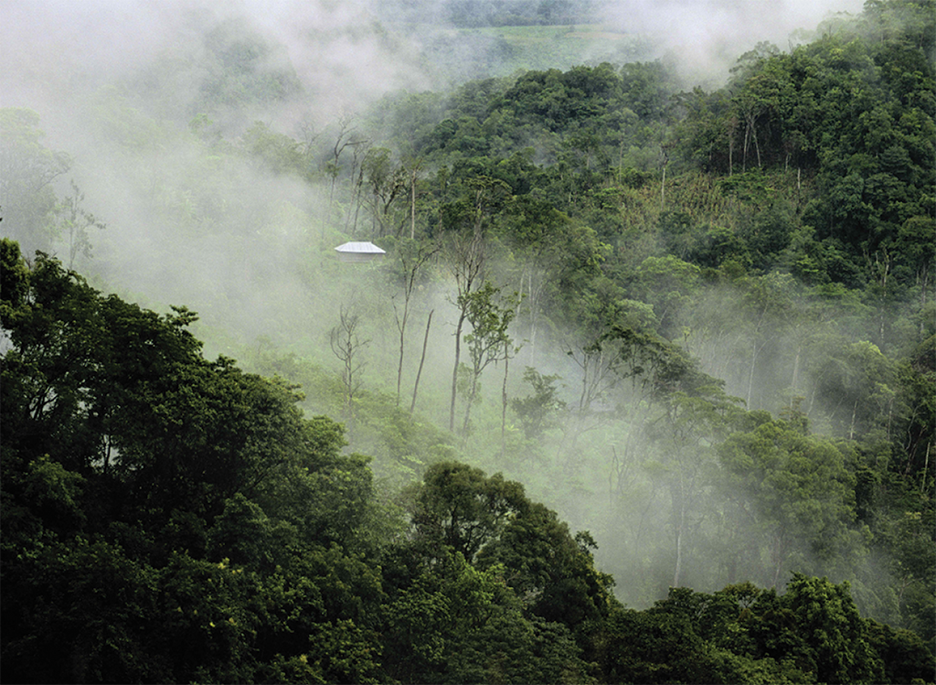
Plant-Transpired Mist Rising from a Tropical Forest
Figure 25.15
Adalberto Rios Szalay/Sexto Sol/Stockbyte/Getty Images

Slide 41


Stomata Opening and Closing
  Each stoma in a leaf epidermis is bordered by guard cells.
    Increased turgor pressure in guard cells opens stoma.
    Active transport of
    into guard cells causes water to
    enter by osmosis and stomata to open.
    ions accumulate outside guard cells as
    moves in.
    Opening and closing of stomata are regulated by light.
    A B A (abscisic acid) can also cause stomata to close.

Slide 42
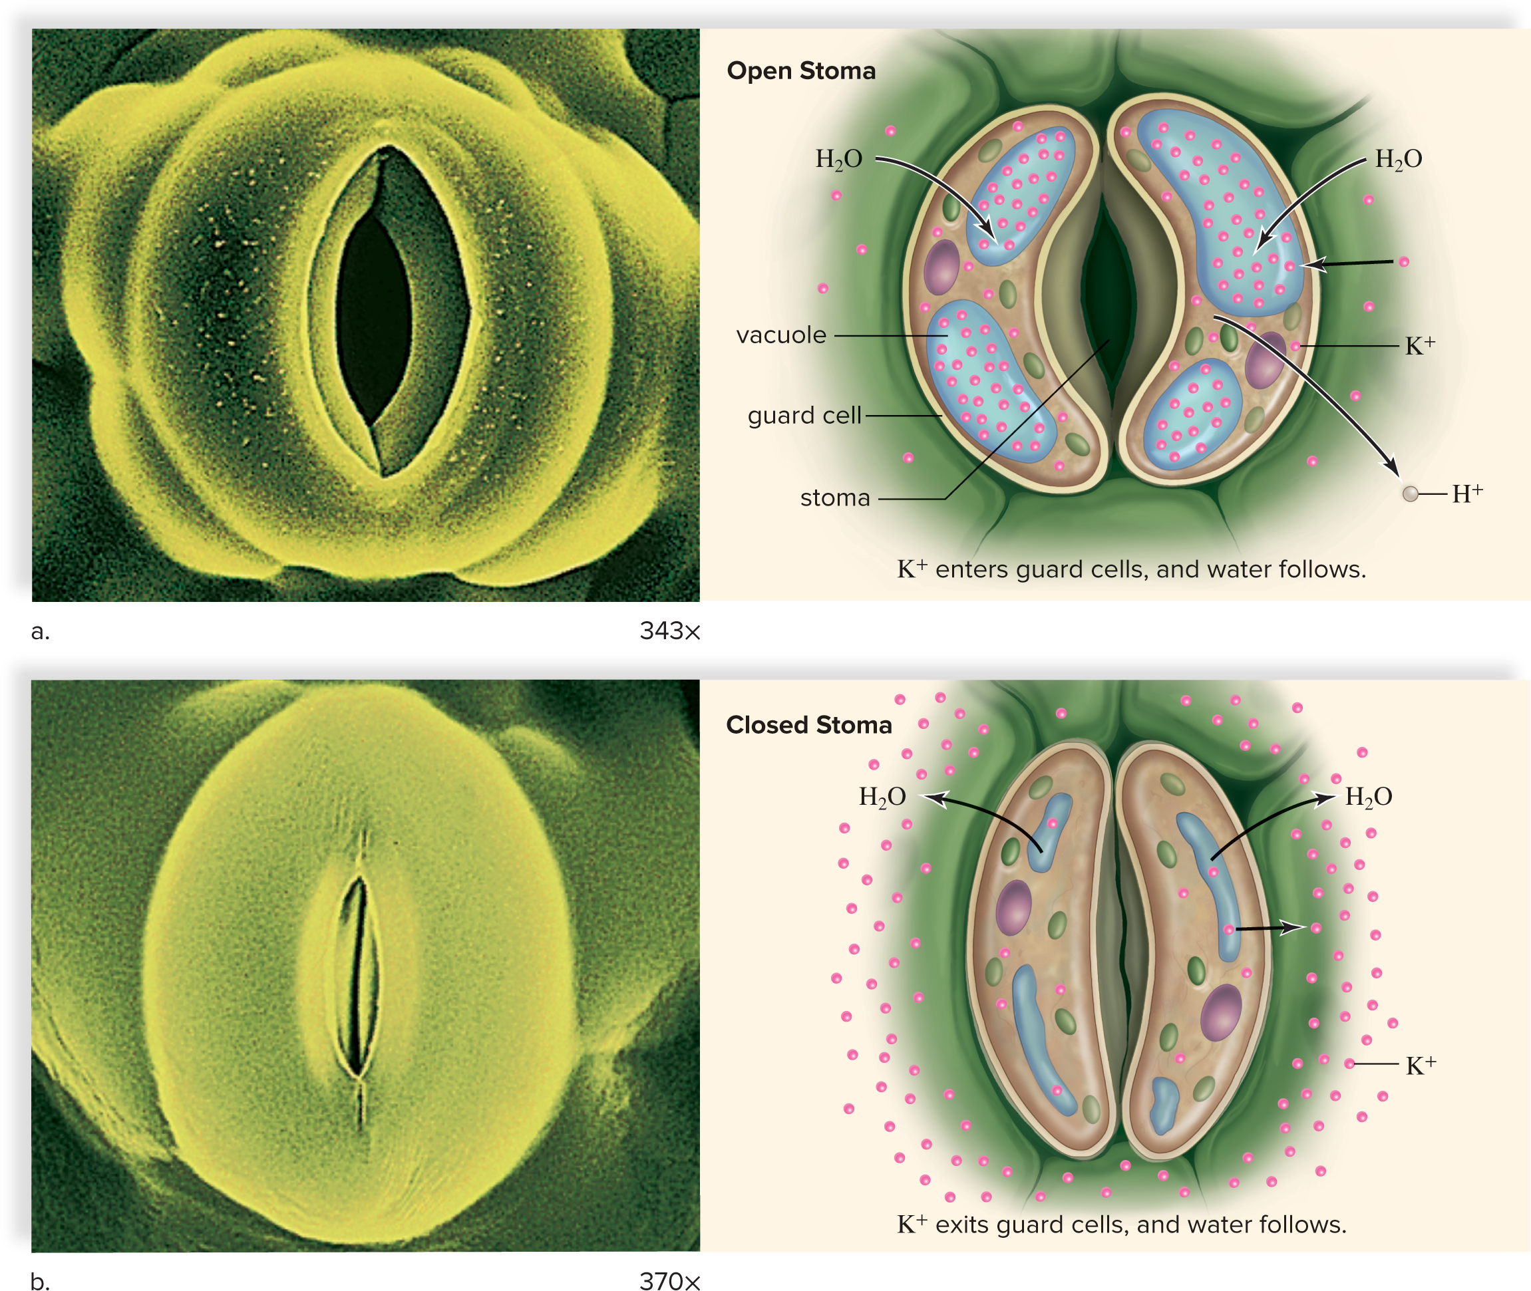
Opening and Closing of Stomata
Figure 25.16
Access the text alternative for slide images.
(both photos): Dr. Jeremy Burgess/Science Source

Slide 43
Role of Phloem
  Phloem transports sugar.
  Phloem sap doesn’t only move upward or downward as xylem does.
  Girdling of tree below the level of leaves causes bark to swell just above the cut.
    Sugar accumulates in the swollen tissue.
  Travels from source (sugar’s origin) to sink (sugars are unloaded).
  Radioactive tracer studies confirm that phloem transports organic nutrients.
    Phloem sap can be collected using aphids.

Slide 44
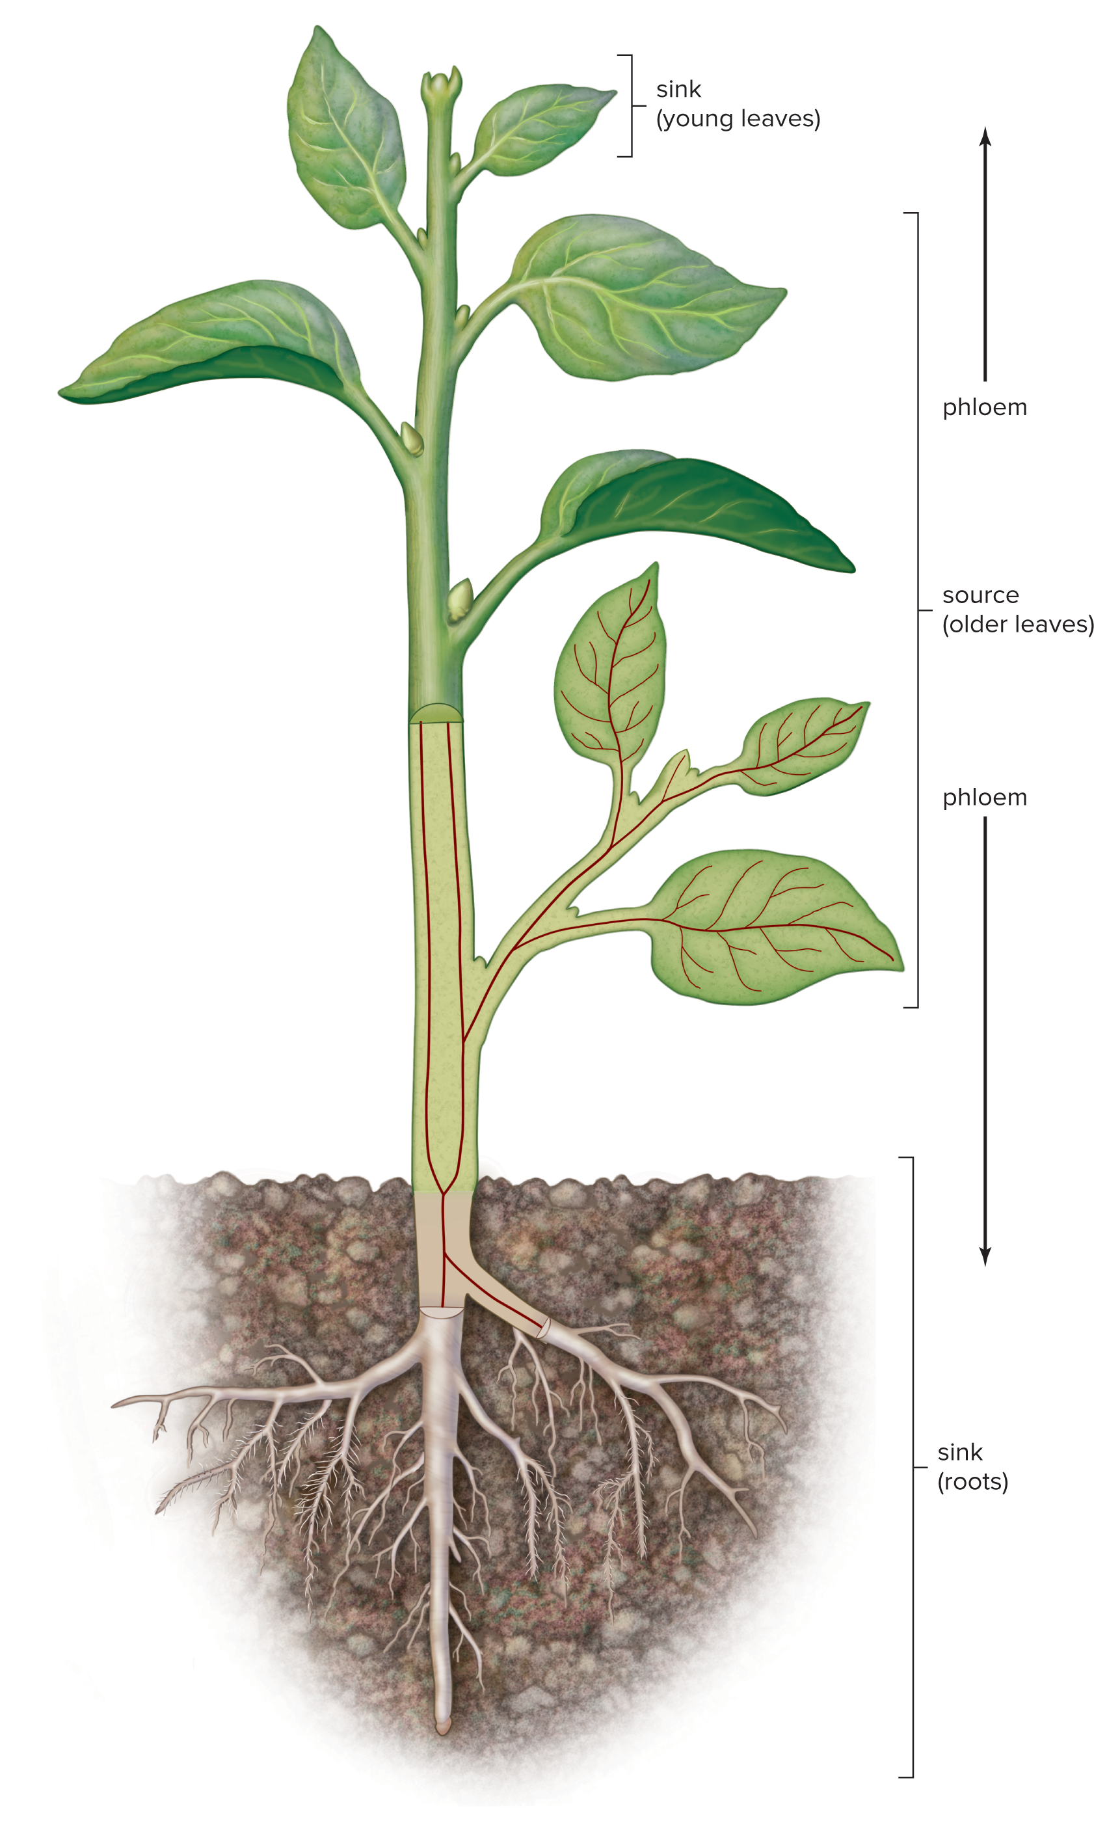
The Movement of Phloem from Source to Sink
Figure 25.17

Slide 45
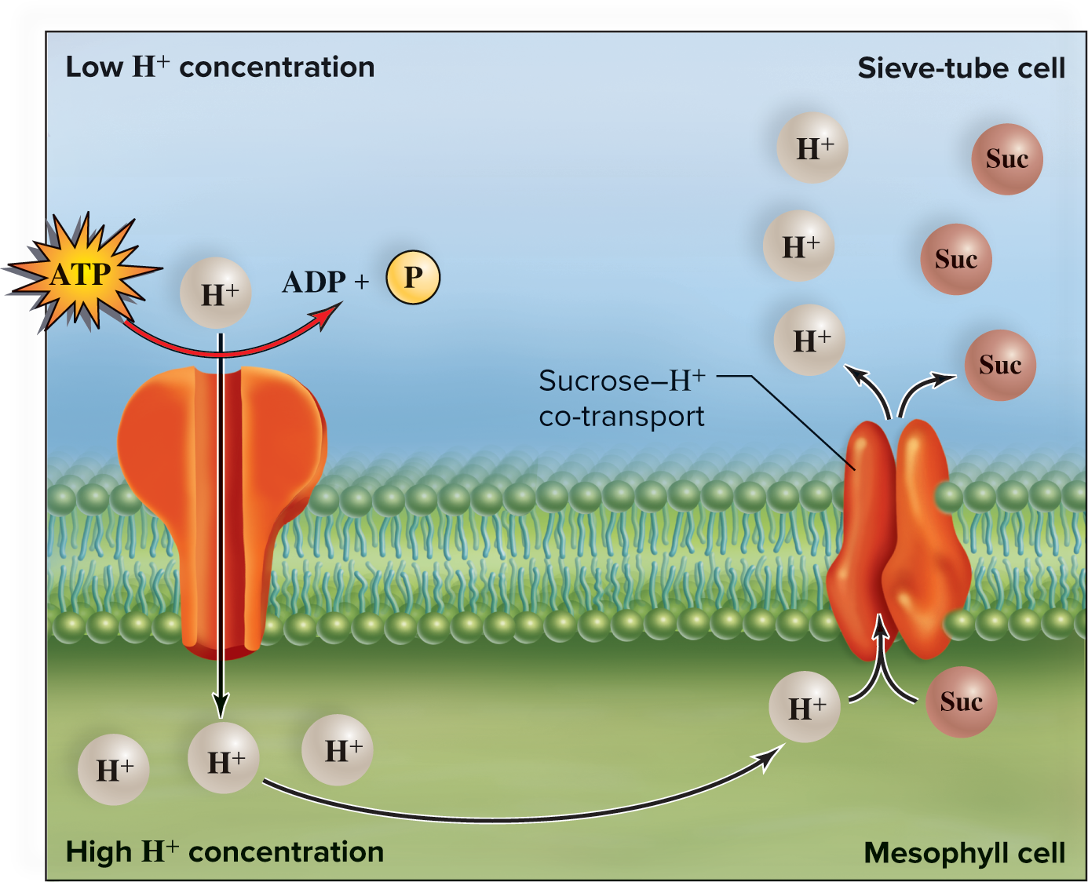
Sucrose Loading Is Dependent on a H⁺ Ion Gradient
Figure 25.18
Access the text alternative for slide images.

Slide 46
Phloem Transport and Pressure-Flow Model
  Sieve tubes form a continuous pathway for organic nutrient transport.
    Sieve-tube members are aligned end to end.
    Strands of plasmodesmata extend through sieve plates between sieve-tube members.
  Positive pressure drives the movement of sap in sieve tubes.
    Sucrose is actively transported into phloem at the leaves.
    Water follows by osmosis, creating positive pressure.
    The increase in pressure causes flow that moves water and sucrose from the source to the sink.

Slide 47
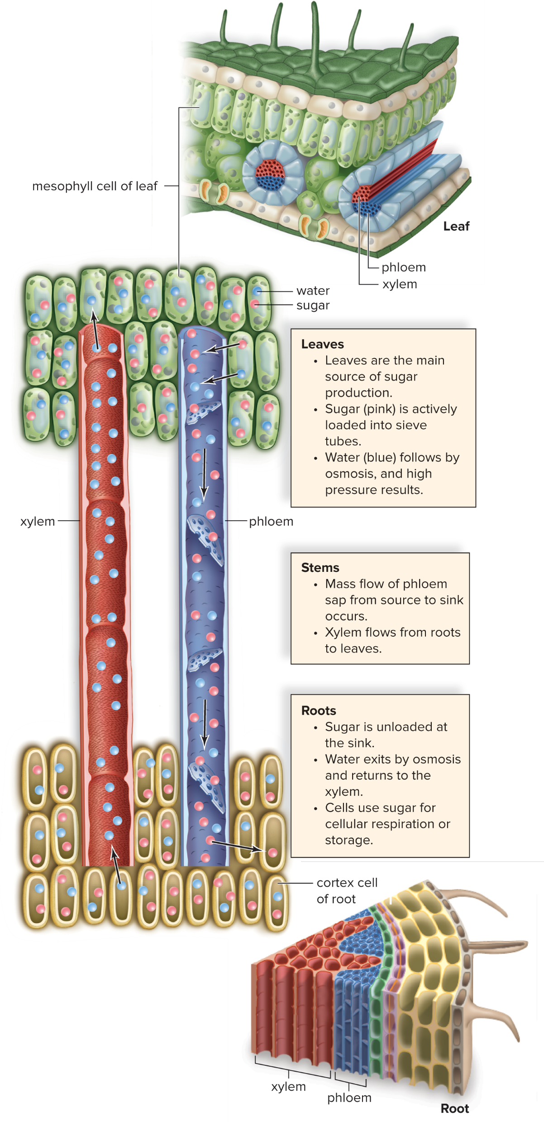
Pressure-Flow Model of Phloem Transport
Figure 25.19
Access the text alternative for slide images.

Slide 48
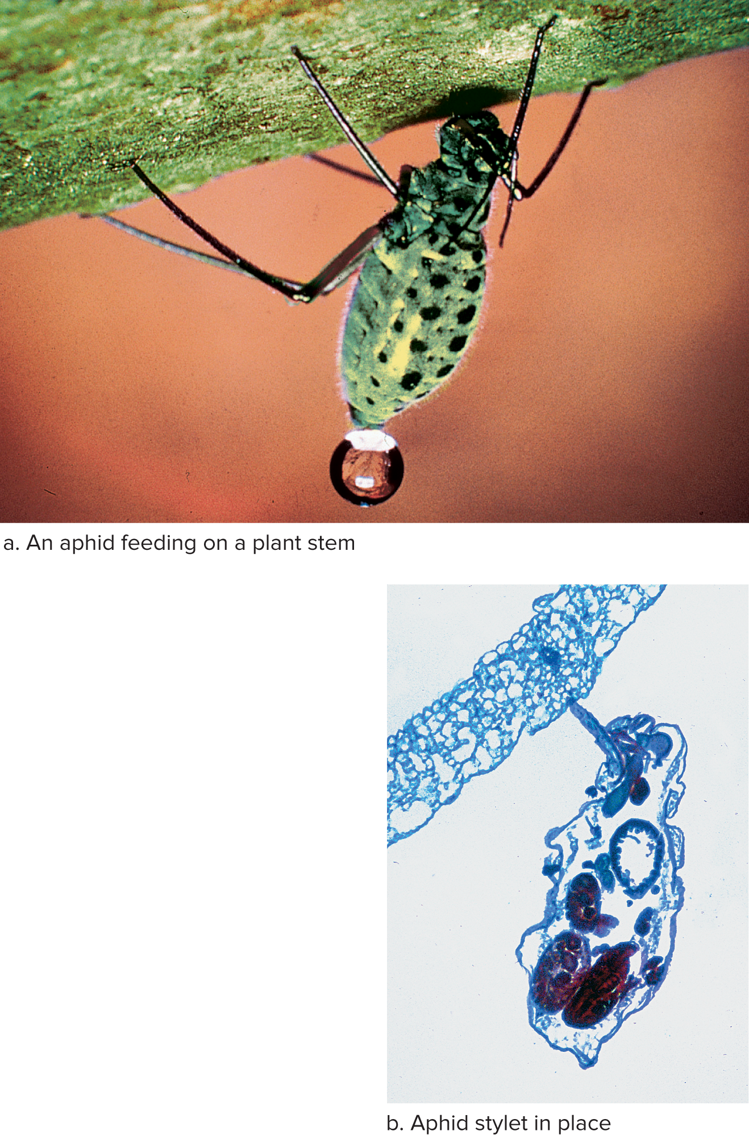
Acquiring Phloem Sap
Figure 25.20
Access the text alternative for slide images.
(a): ©M. H. Zimmermann/Harvard Forest, Harvard University; (b): Steven P. Lynch
Notes:
Figure 25.20

Slide 49
End of Main Content
© McGraw Hill LLC. All rights reserved. No reproduction or distribution without the prior written consent of McGraw Hill LLC.

Slide 50
Accessibility Content: Text Alternatives for Images

Slide 51
Chapter 25 Flowering Plants: Nutrition and Transport - Text Alternative
Return to parent-slide containing images.
The cover image shows the close-up of a Jaguar’s face who is lying on his abdomen surrounded by greenery.
Return to parent-slide containing images.

Slide 52
Hydroponics - Text Alternative
Return to parent-slide containing images.
The illustration shows a large open container filled with nutrient solution. Three floating planters placed on a Styrofoam (floats) are rooted in a cage-like structure containing growing medium. An air pump placed outside the container pumps air into the solution through a pipe connecting three air stones kept in the container below each planter.
Return to parent-slide containing images.

Slide 53
Nutrient Deficiencies and Fertilizer - Text Alternative
Return to parent-slide containing images.
(a) The tomato plant shows the following mineral deficiencies with their impact on leaves: Zinc (Z n) deficiency produces brown spots between the veins; nitrogen (N) deficiency produces light yellow leaves; magnesium deficiency produces yellowing between the veins and leaves are raised and bumpy; potassium (K) deficiency produces brown spots at the tip; and copper (C u) deficiency produces curled leaves. A normal green leaf is also labeled for reference.
(b) The close-up shows a pack of lawn starter fertilizer which is applied when seeding, sodding, or reseeding. An enlarged view shows the back label with NPK (nitrogen phosphorus potassium) value as 18 24 6. Nitrogen is for lush, green plant growth; phosphorus is for strong root development; and potassium is for overall plant vigor. The ingredients are also listed in the label.
Return to parent-slide containing images.

Slide 54
Components of Healthy Soil - Text Alternative
Return to parent-slide containing images.
The enlarged view shows a root hair extending into the soil from the epidermis of the primary root. The soil contains different sized soil particles with air space in between enclosed in a film of water. Potassium (K plus) and calcium (C a 2 plus) ions are bound to negatively charged soil particles. Cation exchange shows the root hair absorbing K plus and C a 2 plus from soil particles while releasing H plus in the soil.
Return to parent-slide containing images.

Slide 55
Simplified Soil Profile - Text Alternative
Return to parent-slide containing images.
The layers from top to bottom with increasing thickness are as follows: Leaf litter and plant life; Topsoil (A) containing partially decomposed organic matter above and well decomposed organic matter below; Subsoil (b) containing mineral leached from rocks and accumulating from above; and Bedrock (c) containing weathered bedrock material.
Return to parent-slide containing images.

Slide 56
Water and Mineral Uptake 2 - Text Alternative
Return to parent-slide containing images.
(a) The micrograph at 300 times magnification shows plus-shaped xylem is surrounded by phloem which is encircled by pericycle and then endodermis. A thick layer of cortex surrounds the vascular cylinder. An enlarged view shows following layers from inside out: vascular cylinder, pericycle, endodermis and Casparian strip, and cortex. Root hair arise from the outermost epidermis. Pathway A shows water and minerals passing between the cell walls of epidermis and cortex to enter the endodermis and Casparian strip. Pathway B shows water and minerals passing through the root hair into the cells of epidermis and cortex to enter the endodermis and Casparian strip.
(b) An enlarged view from the endodermis shows a bilayer plasma membrane with three channel proteins. Water is present outside the endodermal cell.
Step 1. An ATP-driven pump transports H plus out of the endodermal cell while breaking own ATP into ADP plus P inside the cell.
Step 2. The electrochemical gradient causes K plus to enter the endodermal cell by way of a channel protein.
Step 3. Negatively charged ions (N O3 minus) are transported along with H plus into cell.
Return to parent-slide containing images.

Slide 57
Mycorrhizae - Text Alternative
Return to parent-slide containing images.
The illustration shows a small plant with two leaves and multiple small roots on the left and a tall plant with several leaves and a mass of long branched roots (mycorrhizae) on the right. The micrograph at 100 times magnification shows a cross-section through the roots of the tall plant. Several irregular-shaped root cells contain large blue mycorrhizae.
Return to parent-slide containing images.

Slide 58
Other Ways Plants Acquire Nutrients - Text Alternative
Return to parent-slide containing images.
The close-up in part (a) shows a green host plant with long, slender, brown vines of dodder (Cuscuta) wrapped around it. The close-up in part (b) shows cape sundew (Drosera capensis) with green strap-like leaves having narrow form and covered in bright red sticky hairs with white rounded tips. An enlarged view shows an enfolded sundew leaf enclosing a prey. The white bulbs on sticky hairs release digestive enzymes.
Return to parent-slide containing images.

Slide 59
Organization of Conducting Cells in Xylem and Phloem - Text Alternative
Return to parent-slide containing images.
(a) The structure of both a tracheid and a vessel element show a hollow cylindrical tube with a series of interconnected vertical cells separated by diagonal perforation plates. The plate is more diagonally long in tracheid than in vessel element. Water molecules move from bottom to top in both by passing through the perforation plates.
(b) The structure of phloem also shows a hollow cylindrical tube with a series of interconnected sieve-tube members separated by diagonal sieve plates in different directions. An elongated nucleated companion cell lie on either side. Sugar molecules move in both directions (toward the top and bottom) by passing through the sieve plate.
Return to parent-slide containing images.

Slide 60
Plant Transport and Water Potential - Text Alternative
Return to parent-slide containing images.
An arrow from the plant’s root points to the cross-section of a root. The water potential is higher in the soil as compared to the roots, so water moves in and passes through the cells to reach the xylem. In the roots, water flows up through the xylem and sugar moves down through the phloem.
An arrow from the plant’s stem points to the cross-section of a stem. The water potential is lower in the stem as compared to the roots. Water flows up through the xylem and sugar moves down through the phloem.
An arrow from the plant’s leaf points to the cross-section of a leaf. The water potential is lower in the leaves as compared to the stem. The leaf cross-section shows spongy mesophyll layer with spherical cells and intercellular spaces in between, xylem, and phloem. Stoma openings are present in the lower epidermis. Water molecules are depicted in the intercellular spaces. C O2 enters and water and oxygen exits the leaf through the stoma.
Return to parent-slide containing images.

Slide 61
Water Potential and Turgor Pressure - Text Alternative
Return to parent-slide containing images.
(a) Plant cells need water and are wilted. A cross-section shows a shrivel plant cell with shrunken central vacuole. The extracellular fluid has higher water potential, higher pressure potential, and higher osmotic potential. Inside the cell there is lower water potential, higher pressure potential, and higher osmotic potential. As a result, the plant wilts in absences of water.
(b) Plant cells have water and are turgid. A cross-section shows an enlarged plant cell with swollen central vacuole due to intake of water from outside. There is equal water potential inside and outside the cell. Pressure potential increases until the cell is turgid. As a result, the plant becomes turgid in presences of water.
Return to parent-slide containing images.

Slide 62
Cohesion-Tension Model of Xylem Transport - Text Alternative
Return to parent-slide containing images.
An arrow from the tree’s crown points to the cross-section of a leaf. The mesophyll cells have intercellular spaces between spherical cells and a xylem in the leaf vein. Stoma openings are present in the lower epidermis. Water molecules are depicted in the intercellular spaces. Water (H2O) exits the leaf through the stoma. In the leaves. Transpiration creates tension and tension pulls the water column upward from the roots to the leaves.
An arrow from the tree’s stem points to the cross-section of xylem made of several adjacent hollow cylindrical tubes separated by cell walls. Each xylem tube is made of interconnected vertical cells with water molecules moving upward. An enlarged view of a cell shows water molecules interconnected by dashed lines labeled, cohesion by hydrogen bonding between water molecules. The inside of the cell is labeled, adhesion due to polarity of water molecules. Cohesion makes water continuous and adhesion keeps water column in place.
An arrow from the tree’s root points to the cross-section of a root showing water molecules moving from soil to the root hair, root cell, and then the xylem. Water molecules moving upward in the xylem. Water column extends from leaves to the root.
Return to parent-slide containing images.

Slide 63
Opening and Closing of Stomata - Text Alternative
Return to parent-slide containing images.
(a) The micrograph at 343 times magnification shows an open stoma. The illustration shows two bean-shaped guard cells containing a nucleus, chloroplasts, and vacuoles. The guard cells are attached near the top and bottom forming an open small lip-mouth, labeled stoma. The guard cells swell as water (H2O) and K plus ions enter the vacuoles and H plus ions move out of the guard cells.
(b) The micrograph at 370 times magnification shows a closed stoma. The illustration shows the guard cells are thinner due to shrunk vacuoles as water and K plus leave the cells. Several K plus ions are present outside.
Return to parent-slide containing images.

Slide 64
Sucrose Loading Is Dependent on a H⁺ Ion Gradient - Text Alternative
Return to parent-slide containing images.
The bilayer plasma membrane shows two embedded transport proteins. An ATP-driven pump on the left transports H plus from the sieve-tube cell to the mesophyll cell while breaking down ATP into ADP plus P inside the sieve-tube cell. The sucrose-Hydrogen co-transport protein transports H plus and sucrose molecules together from the mesophyll cell to the sieve-tube cell.
Return to parent-slide containing images.

Slide 65
Pressure-Flow Model of Phloem Transport - Text Alternative
Return to parent-slide containing images.
The cross-section of a leaf on the top shows mesophyll cells, xylem and phloem in the leaf vein, and stoma in the lower epidermis. The cross-section of a root at the bottom shows the following layers from inside out: xylem, phloem, pericycle, endodermis, and cortex. Root hair arise from the outermost epidermis. An enlarged view in the middle shows two long cylindrical tubes of xylem and phloem is connected from rod-shaped green mesophyll cells of leaves on top to rod-shaped yellow cortex cells of roots below. Water molecules from cortex cells enter xylem, move upward, and leave into the mesophyll cells. Sugar molecules from mesophyll cells enter phloem, move downward, and leave into the cortex cells. Text reads as follows:
Leaves: They are main source of sugar production. Sugar is actively loaded into sieve tubes. Water follows by osmosis, and high pressure results.
Stems: Mass flow of phloem sap from source to sink occurs. Xylem flows from roots to leaves.
Roots: Sugar is unloaded at the sink. Water exits by osmosis and returns to the xylem. Cells use sugar for cellular respiration or storage.
Return to parent-slide containing images.

Slide 66
Acquiring Phloem Sap - Text Alternative
Return to parent-slide containing images.
(a) The close-up shows a green aphid feeding on a plant stem. A small droplet of translucent liquid is present on the posterior tip of the aphid. (b) The micrograph shows the aphid with its needle-like stylet inserted into the stem. The aphid has dark and light-colored ovals inside the body.
Return to parent-slide containing images.

